Slide 1


ANLY-500
AN ANALYSIS OF HOUSE SALES
Huili Xing, Rumana Myageri, Xunfan Cai

Slide 2
INTRODUCTION & DATA SCREENING
The dataset consists of house sales for X county between May 2014 and May 2015.
It includes sales price and characters for over 21,000 houses sold
Variable Name | Variable Description
Id | Sales ID
Price | Sales Price
Bedrooms | Number of Bedrooms
Bathrooms | Number of bathrooms
Sqft_living | Square footage of the living area
Sqft_lot | Square footage of the plot
Floors | Total floors (levels) of the house
Waterfront | Does it have a waterfront view
Condition | How good the condition of the house is
Grade | Overall grade given to the housing unit, based on King County grading system
Sqft_above | Square footage of the house apart from the basement
Sqft_basement | Square footage of the basement
Yr_built | Year the house was built
Yr_renovated | Year the house was renovated
Age | Age of the house in years at the time of sale
Last 4 columns of data with missing values were dropped using na.omit.
Using Mahalonobis a cutoff score was found, and outliers were removed

Slide 3
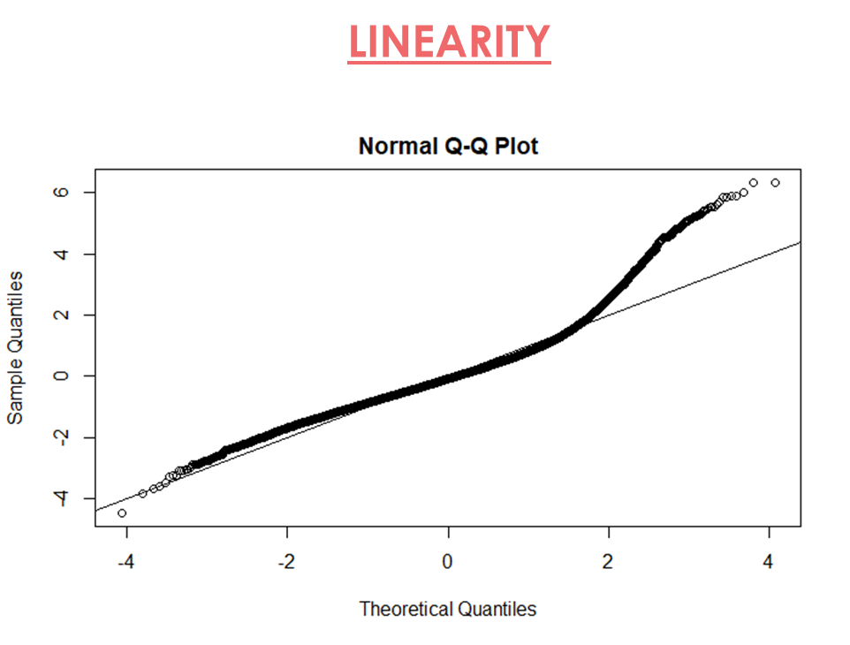
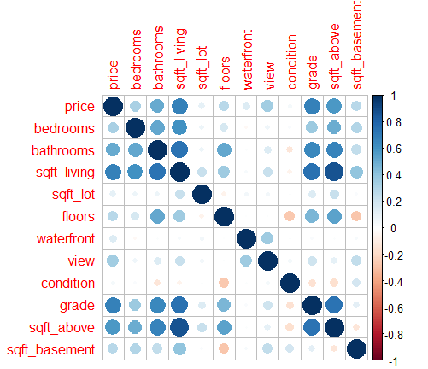
DATA SCREENING
ASSUMPTIONS
Correlation table-Additivity

Slide 4
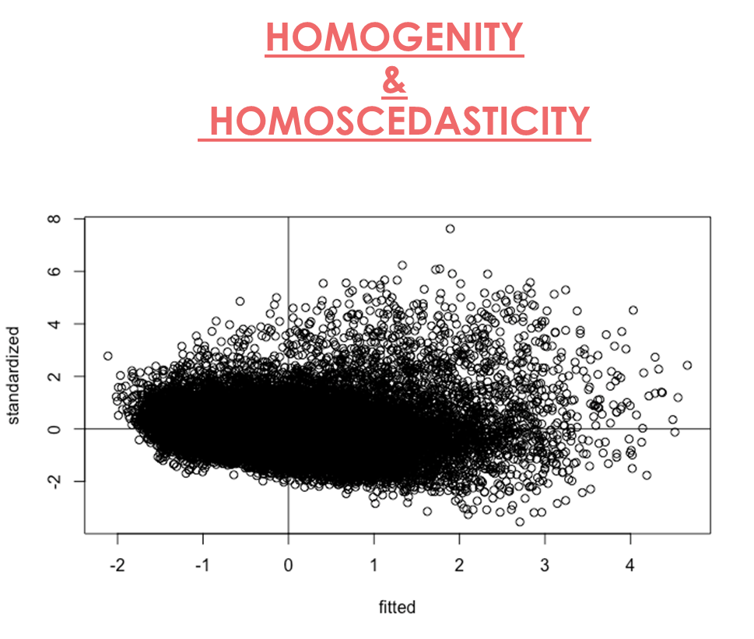
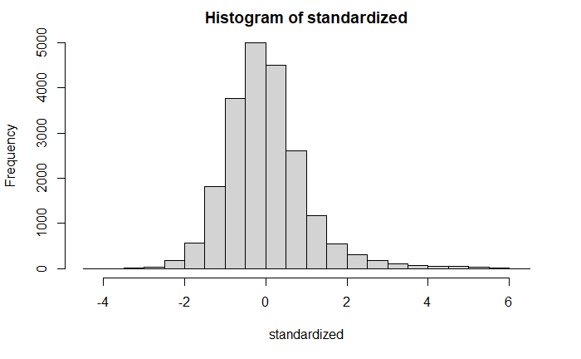
DATA SCREENING
ASSUMPTIONS
NORMALITY
Notes:
The normal probability plot is a graphical tool for comparing a data set with the normal distribution. We can use it with the standardized residual of the linear regression model and see if the error term ϵ is actually normally distributed.

Slide 5
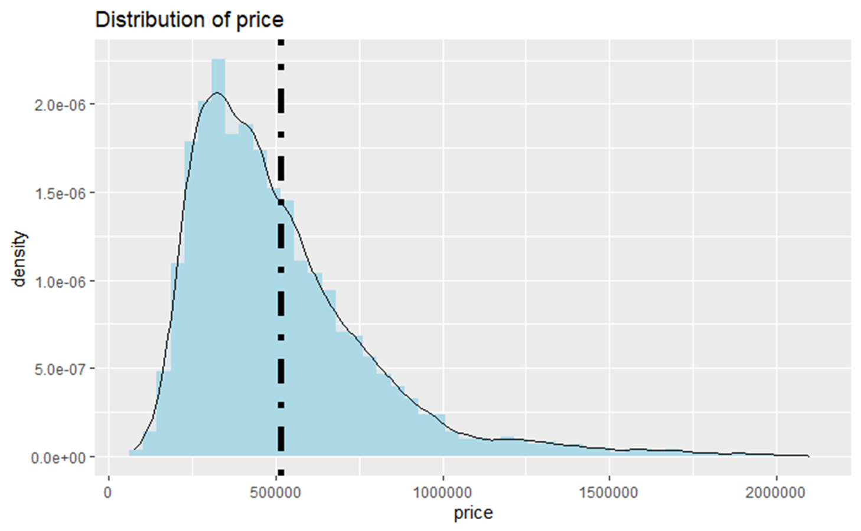
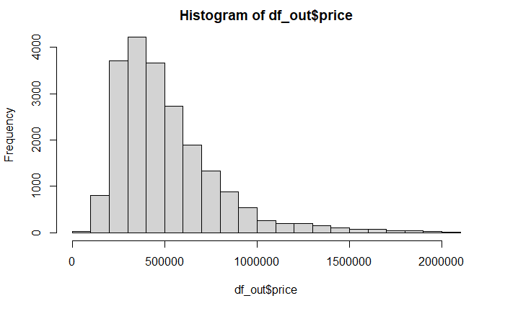
EXPLORATORY DATA ANALYSIS
PRICE IS POSITIVELY SKEWED

Slide 6
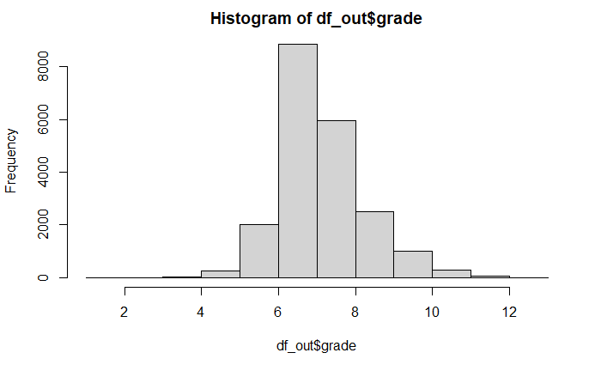
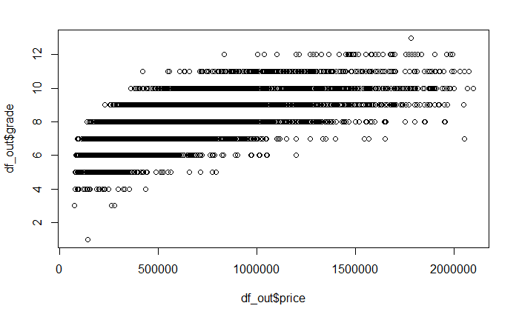
EXPLORATORY DATA ANALYSIS
ANALYZING DISTRIBUTION & RELATIONSHIPS OF CHARACTERISTICS
RELATIONSHIP BETWEEN PRICE & GRADE
NORMAL DISTRIBUTION OF GRADE

Slide 7
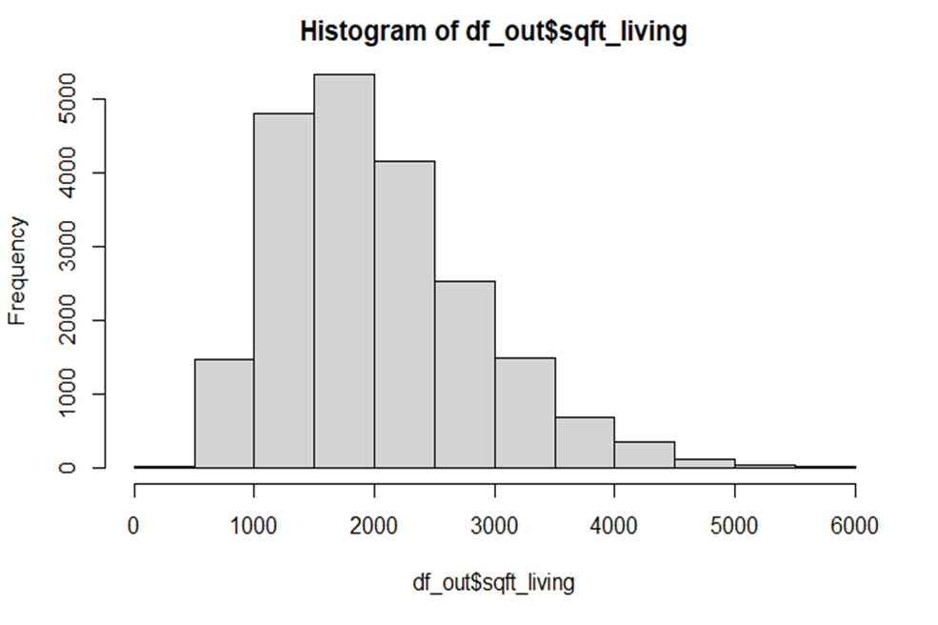
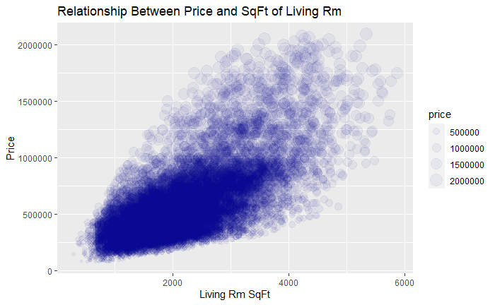
EXPLORATORY DATA ANALYSIS
ANALYZING DISTRIBUTION OF CHARACTERISTICS
RELATIONSHIP BETWEEN PRICE & LIVING RM SQFT
DISTRIBUTION OF LIVING RM SQFT

Slide 8
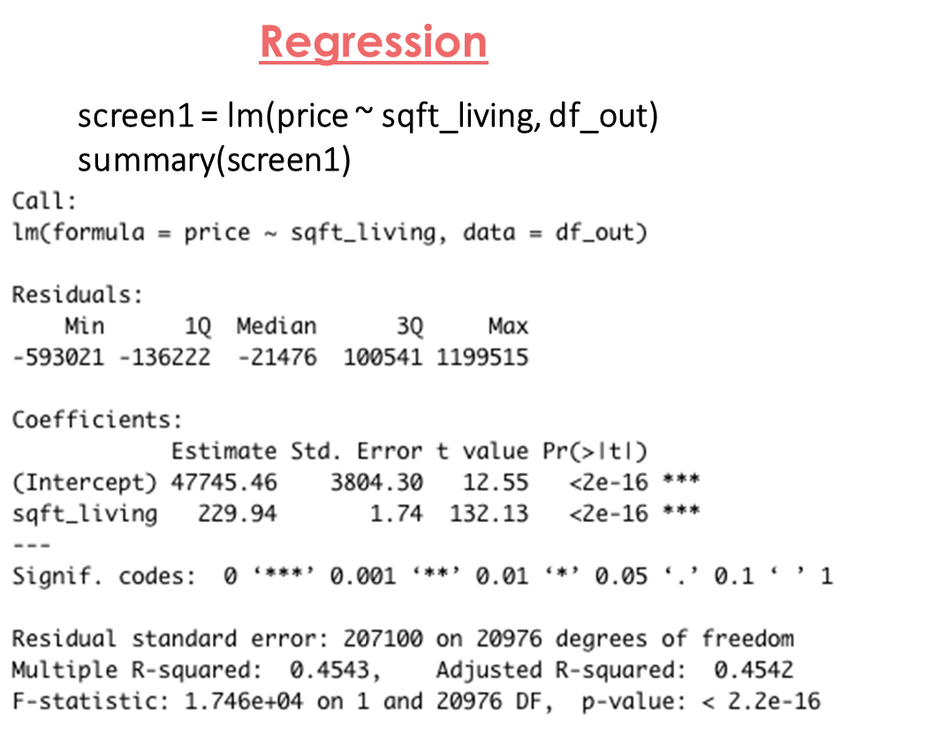
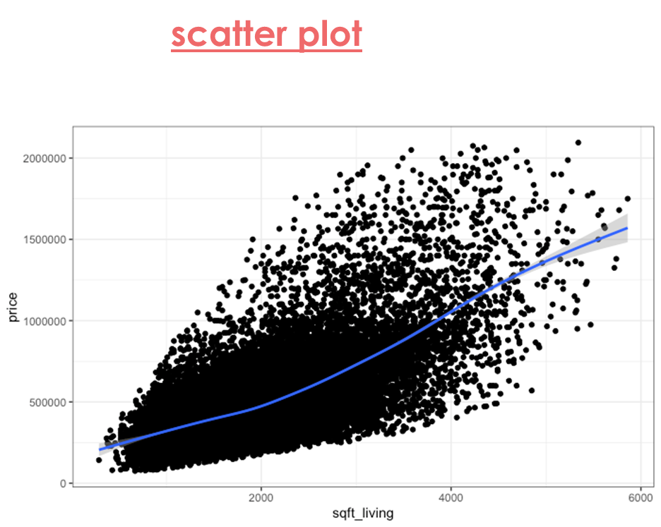
MODELING
Hypothesis Testing

Slide 9
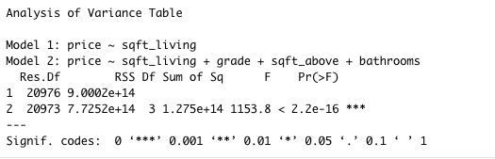
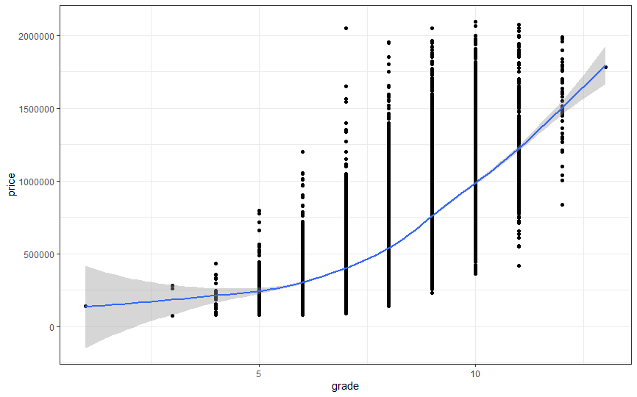
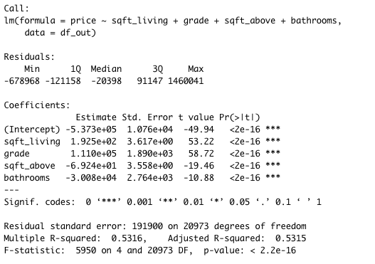
ANOVA
MODELING
Hypothesis Testing
MLR
screen2 = lm(price ~ sqft_living + grade + sqft_above + bathrooms, df_out)

Slide 10
CONCLUSION
RESULTS OF ANALYSIS AND MODELING
EDA showed us that price of houses and SqFt of living room and grade were positively associated.
Linear Regression Modeling was done using SqFt of Living Room, grade, SqFt above and bathrooms .
The model achieved an adjusted R- Squared of 53%
Therefore, we can say that prices of houses for county X are impacted by the above features.

Slide 11
THANK YOU!
AN ANALYSIS OF HOUSE SALES
Huili Xing, Rumana Myageri, Xunfan Cai

